Slide 1
Big Data Xpress
Ajinkya Rode Harshit Shah Ninad Ingale Shikha Soni
Computer Science
Rochester Institute of Technology

Slide 2

Employment Status
Employment status is predicted on the basis of :
age
sex
citizenship
marital status

Slide 3
Description / Columns used :
age :
grouped into four categories : 18, 27, 58, 65
sex :
male or female
education :
grouped into three categories : School Level, Bachelor’s Degree, Master’s Doctorate Degree.
citizenship :
grouped into two categories : US Citizen, Not a US Citizen
marital_status :
grouped into two categories : Married, Unmarried

Slide 4
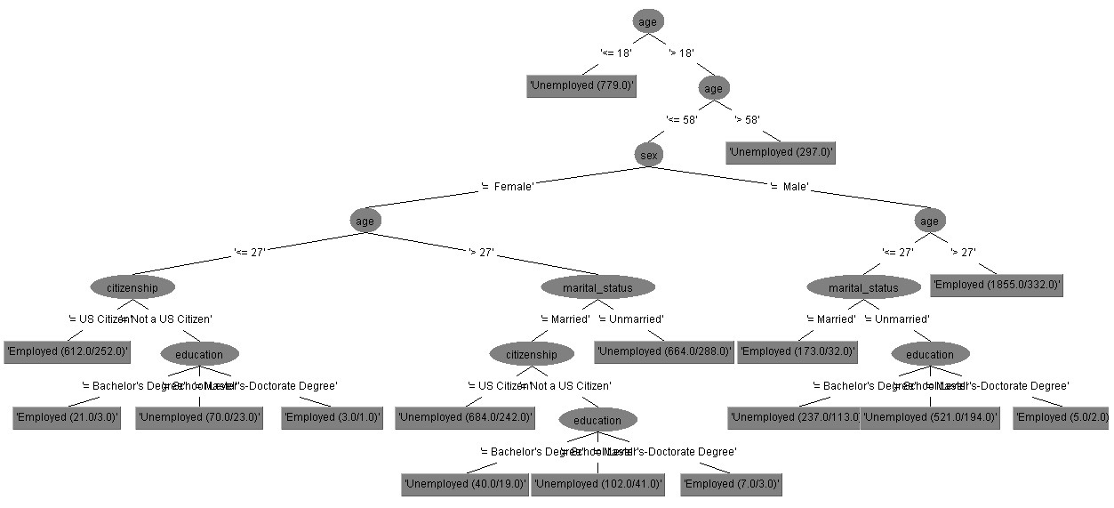

Slide 5
Results : - Manufacturing non Durable/ Durable goods: Prefers only Males in industry - Retail trade: Females with school level education and Bachelor level are preferred, provided their ages - Education: This industry only prefers the female population

Slide 6
Preferred Gender in Industry
Introduction
Preferred Gender in a given industry based on their ages and education
In the virtue to find out the industries preferences of the population in the country

Slide 7
Description / Columns used :
age :
grouped into four categories : 18, 27, 58, 65
education :
grouped into three categories : School Level, Bachelor’s Degree, Master’s Doctorate Degree
sex :
male or female
industry_code :
grouped into 5 categories based on population count

Slide 8
Region wise Development
Introduction :
We analyze the development of the country based on the population in:
industries
occupations

Slide 9
Description / Columns used :
industry_code :
22 distinct industry codes
occupation_code :
11 distinct occupation codes for each industry code
curr_region :
4 regions - North South East West
state_curr_residence :
48 distinct states

Slide 10
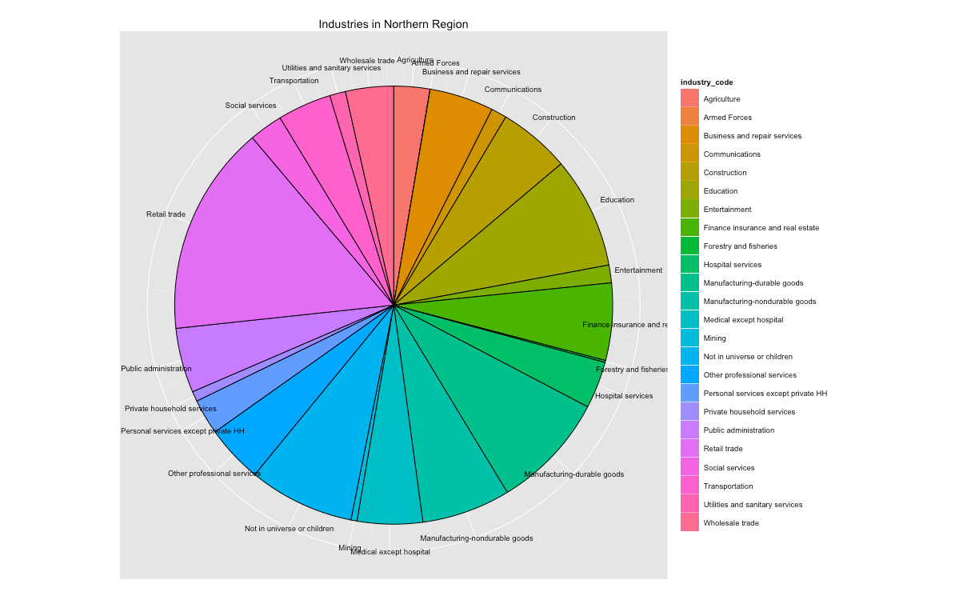


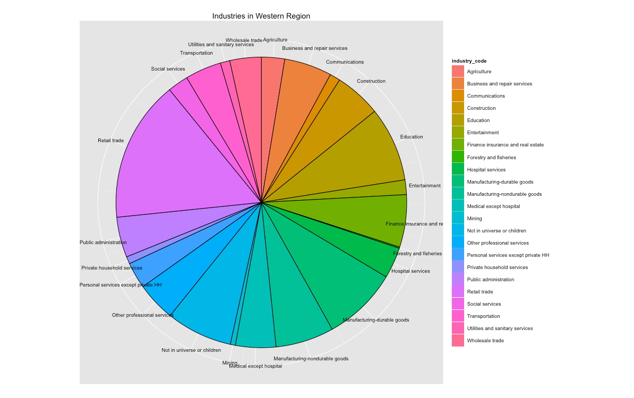
Region wise Industries

Slide 11
Region wise Industries

Slide 13
North
South
Most populated
Industry
East
West

Slide 14
Statistics : - Most populated industry : Retail Sales - We further drill down in this industry for occupations in all regions.

Slide 15
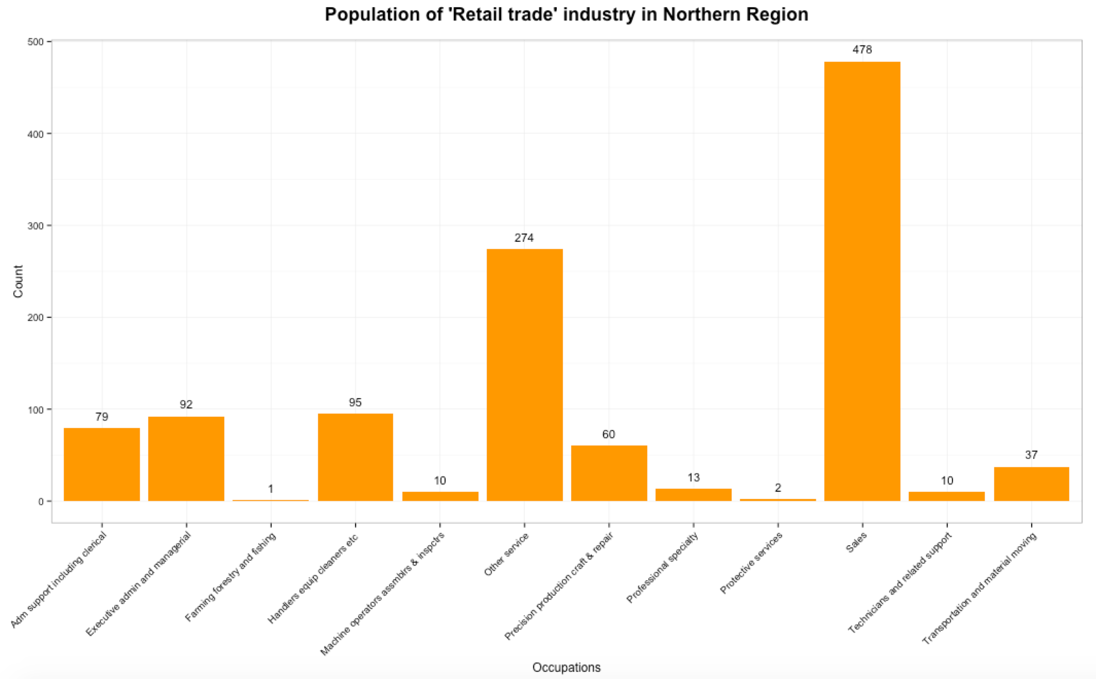
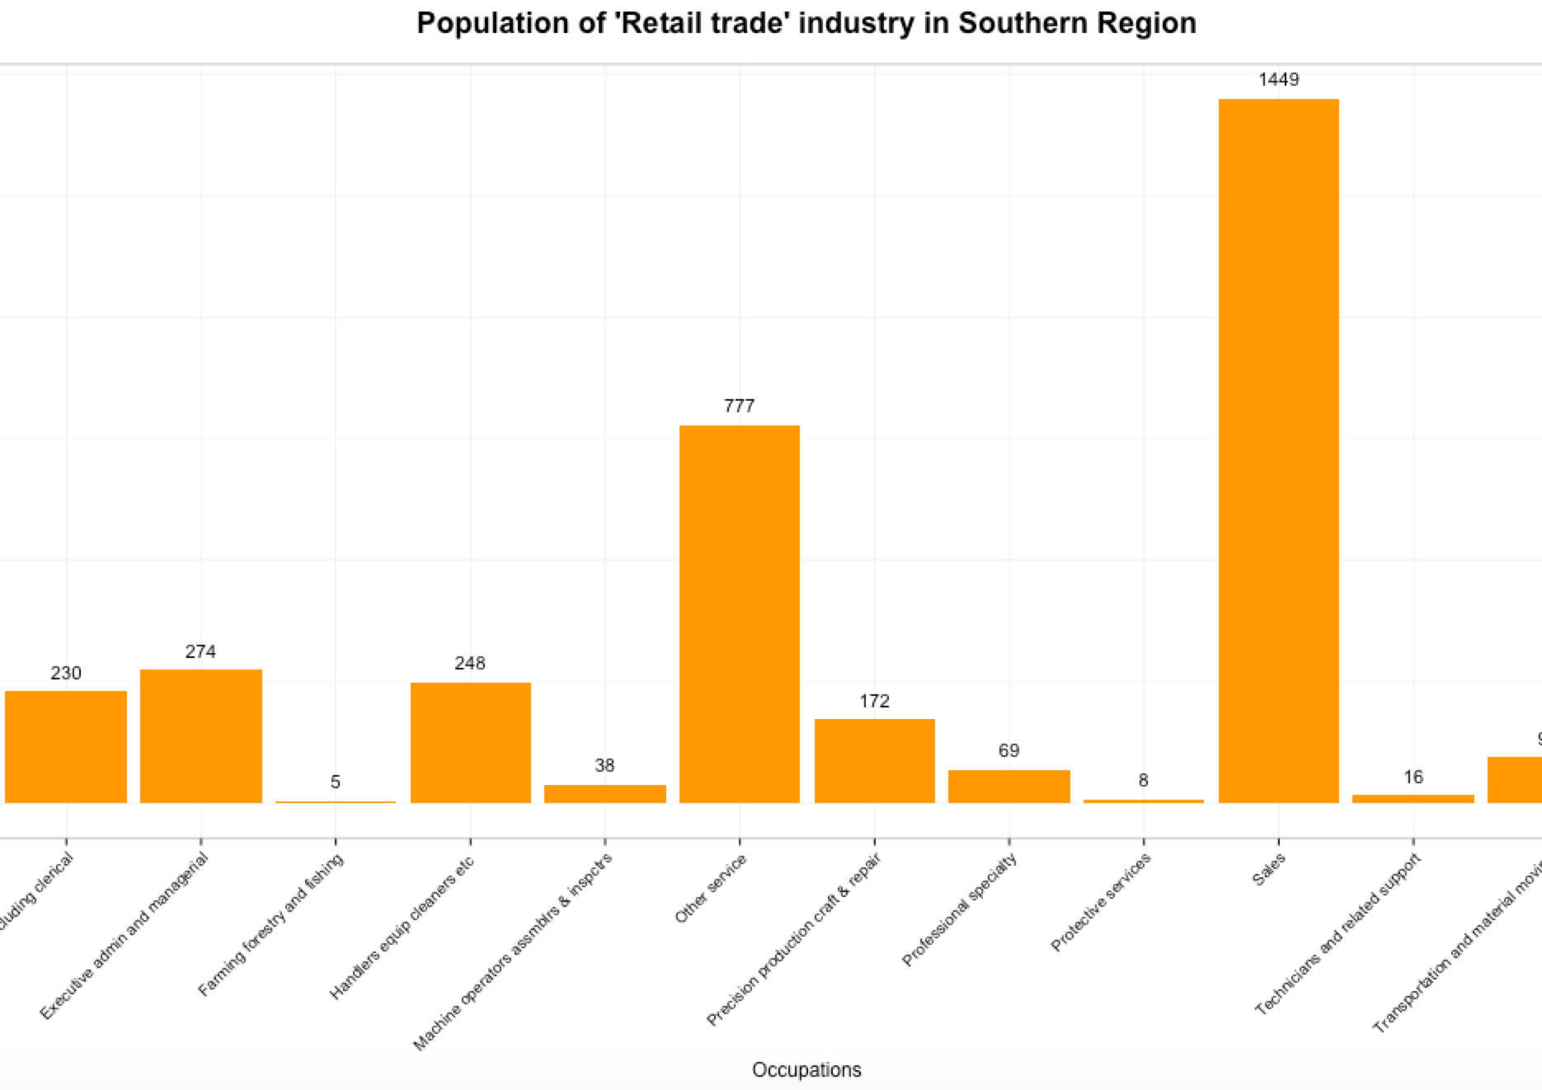
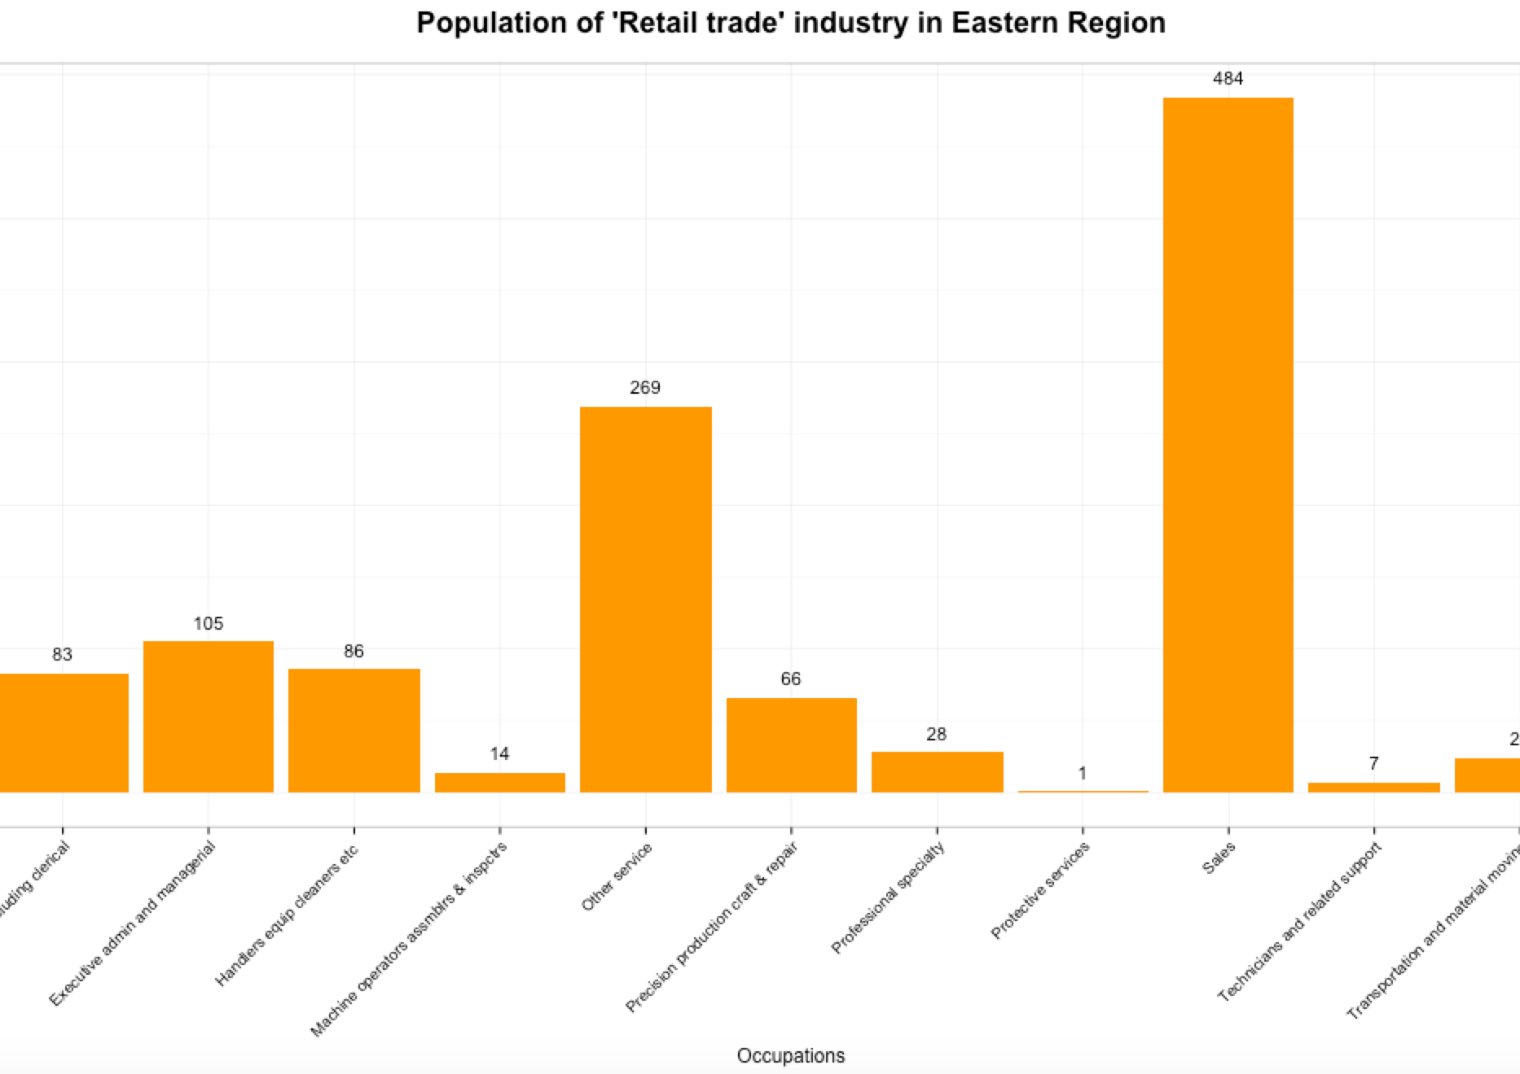
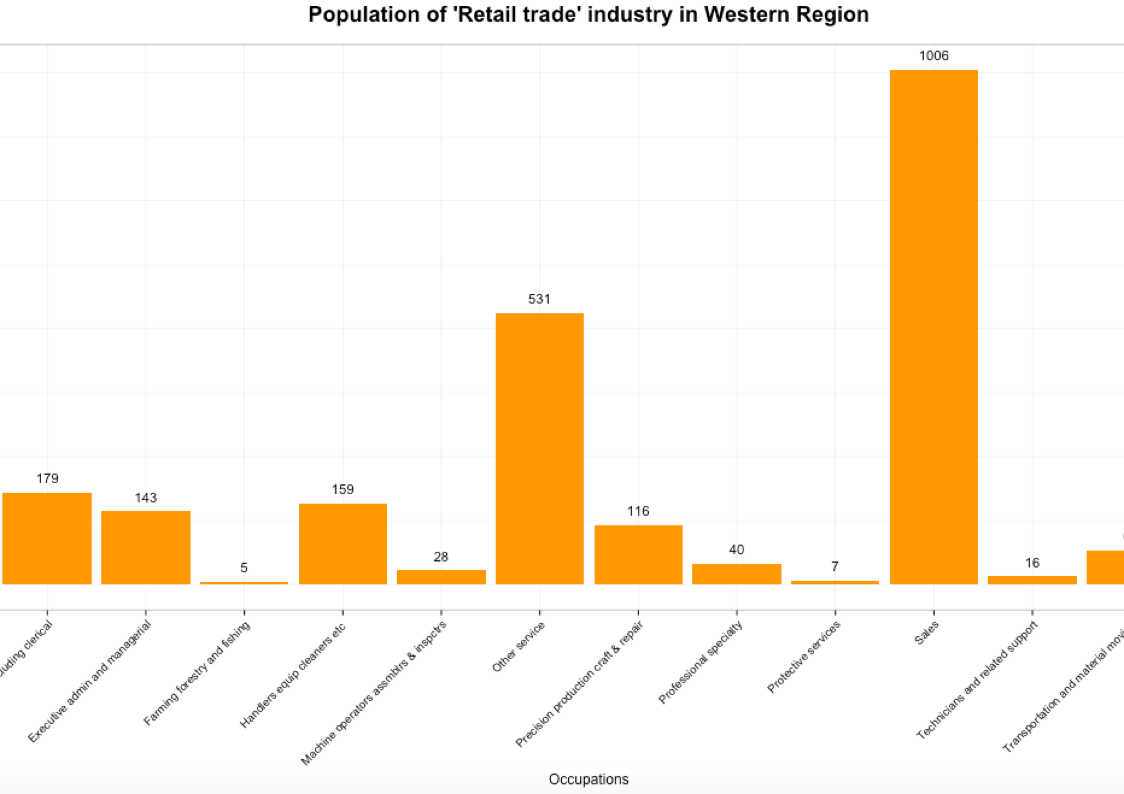
Region wise Occupation : “Retail Sales”

Slide 16
Region wise Occupation : “Retail Sales”

Slide 17
Result : - The most influential industry in terms of development in the entire country is “Retail Sales”. - It was analyzed on the basis of the population, i.e maximum population in any industry.

Slide 18
Industry wise Average Income
Average annual income is analyzed on the basis of :
Wages per hour
sex
industry codes

Slide 19
Description / Columns used :
wage_phour :
wage per hour
weeks_year :
weeks worked in a year
industry_code :
22 distinct industry codes
Formula used :
Annual income = wage_hour * weeks_year * 40

Slide 20
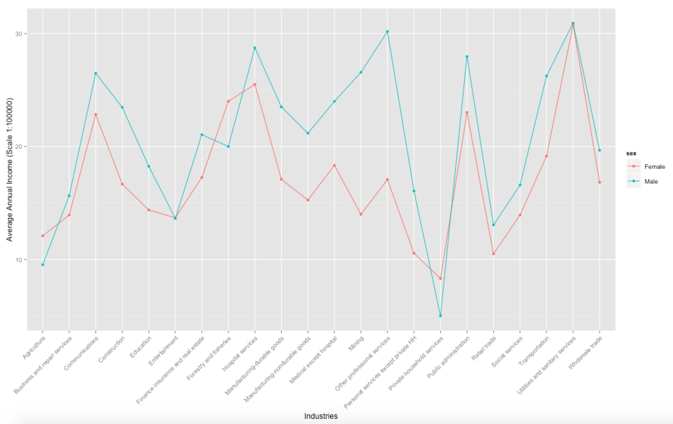
Industry wise Average Annual Income

Slide 21
Result - The general pattern that can be observed here is : except for industries like Agriculture, Forestry, and Private household services, all the industries have males with higher annual income - It is unpredictable and needs an improvement

Slide 22
Income Tax Analysis
Introduction : Income tax is calculated on the basis of :
Wage per hour
Weeks worked in a year
Tax filer status

Slide 23
Description / Columns used :
wage_phour :
wage per hour
weeks_year :
weeks worked in a year
tax_filer_status:
based on age and marital status
Formula used :
Annual income = wage_hour * weeks_year * 40
Tax calculation rules : http://www.unclefed.com/IRS-Forms/1995-1991/1994TaxRateSchedules.pdf

Slide 24
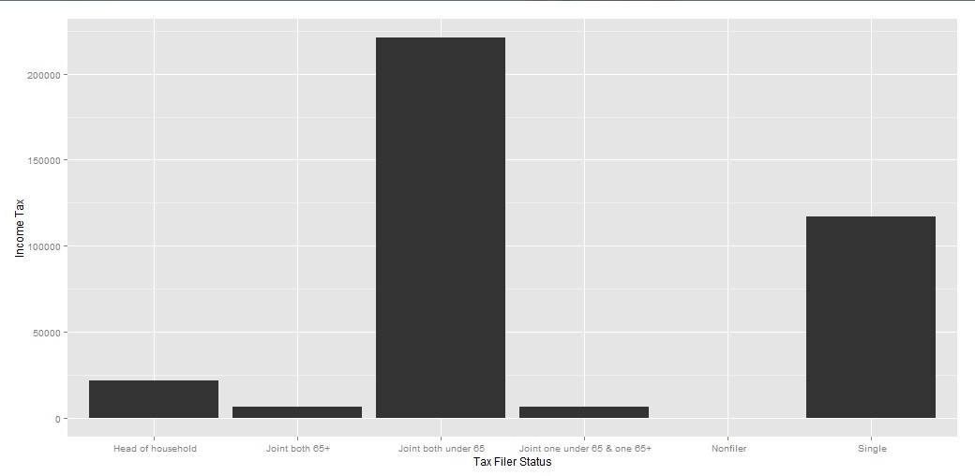
Income Tax Collection

Slide 25
Result : - The most tax paying tax ler group is ‘Joint both under 65'. This is because there is a majority of people from group Joint both under 65 in the dataset

Slide 26
Age wise education for gender
Analyze age wise educated people and comparison between males and females based on
age
education
sex

Slide 27
Description / Columns used :
sex :
wage per hour
education :
weeks worked in a year
age :
22 distinct industry codes

Slide 28
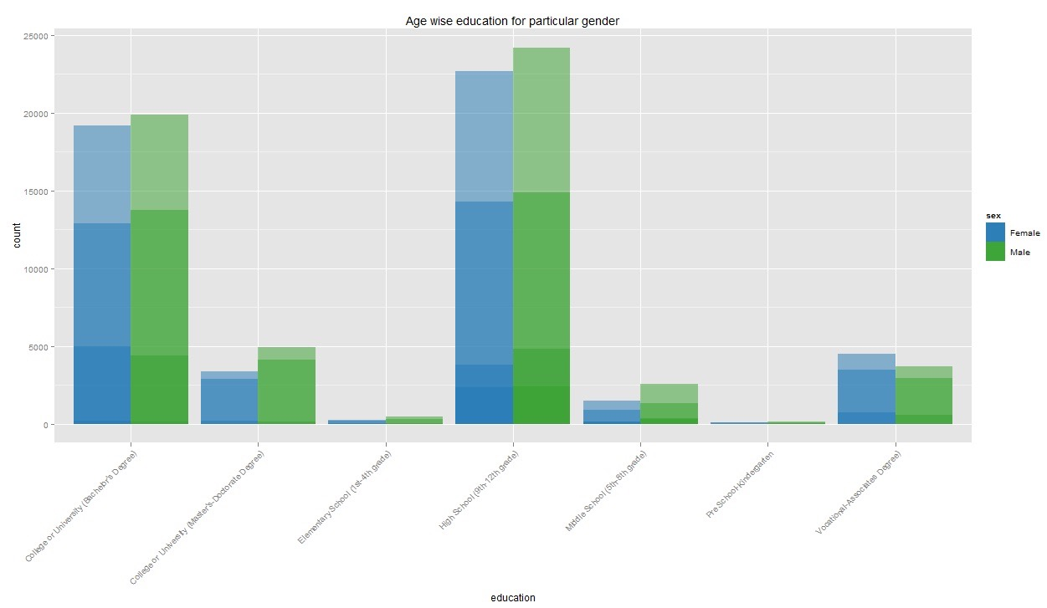
Age wise education

Slide 29
Result : - population of ages less than 18 are limited till high school and college university - Majority of the population studied till either high school or completed their bachelor's at the most - People of the age group 58 have studied till their high school or have attained bachelors degree

